Slide 1

Probability
Anuja P Sobhan

Slide 2
Random Experiment
If an experiment is performed many times under similar conditions and the outcome of each time is not the same, then this experiment is called a random experiment.
Example:
1. Tossing of a fair coin
2. Throwing of an unbiased die

Slide 3
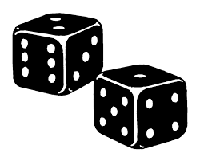
Sample Space
The set of all possible outcomes of a random experiment is called the sample space for that experiment. it is usually denoted by S.
Example:
When a die is thrown, any one of the numbers 1, 2, 3, 4, 5, 6 can come up.
therefore, sample space:
S = {1, 2, 3, 4, 5, 6}

Slide 4
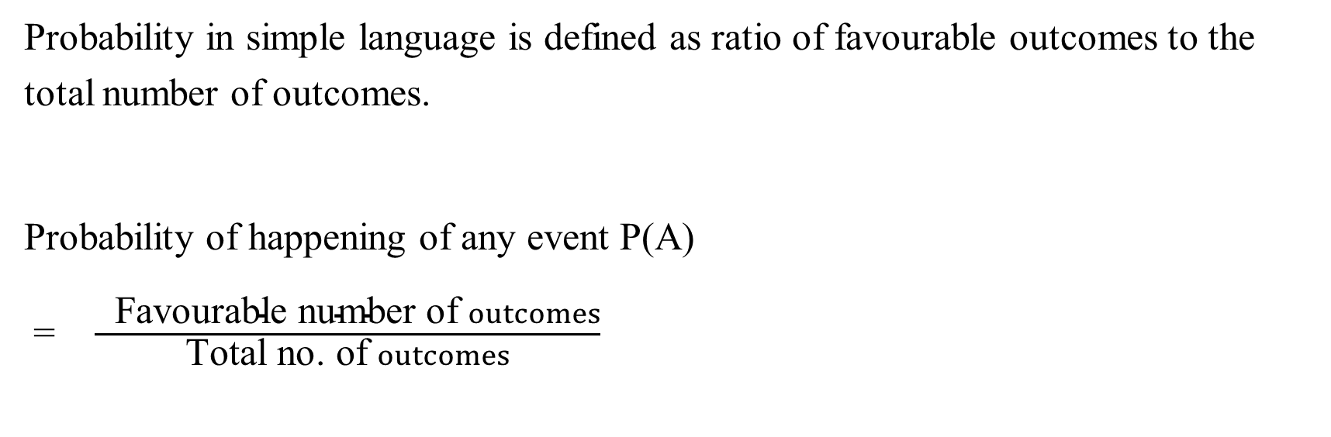
Definition
Probability in simple language is defined as ratio of favourable outcomes to the total number of outcomes.
Probability of happening of any event P(A)
= $\frac{ \text{F}\text{av}\text{ourable} \text{number} \text{of} outcomes}{\text{T}\text{otal} \text{no}\text{. }\text{of} outcomes}$

Slide 5
If the probability of happening of an event is 0, then it is an impossible event.
If the probability of happening of an event is 1, then it is a sure event.
If P is the probability of happening of an event A, then the probability of not happening of that event is P(Ā) = 1- p

Slide 6
Probability Equations: P (A) ≤ 1, P(A) + P(Ā) = 1.
Addition theorem: P(X or Y) = P(X) + P(Y) – P (X∩Y)
or P(X⋃Y) = P(X) + P(Y) – P(X∩Y)
Odds in favor of certain event = No. of successes: No. of failures
Odds against of an event = No. of failures: No. of successes

Slide 7
Equally Likely Events
Outcomes are said to be equally likely when we have no reason to believe that one is more likely to occur than the other.
Example:
When an unbiased die is thrown all the six faces 1, 2, 3, 4, 5, 6 are equally likely to come up.

Slide 8
Mutually exclusive events
Two events are mutually exclusive if they cannot occur simultaneously.
P (A or B) = P (A) + P (B)
where A and B denote mutually exclusive events.
Example:
Tossing a coin: heads and tails are mutually exclusive
Cards: kings and aces are mutually exclusive

Slide 9
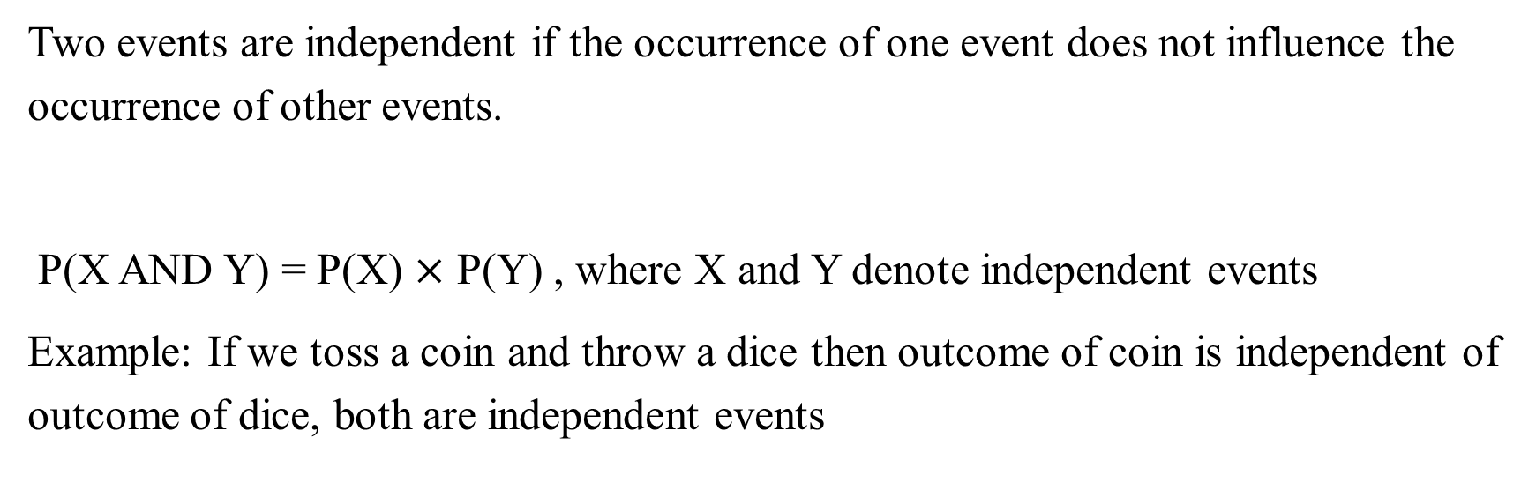
Independent events
Two events are independent if the occurrence of one event does not influence the occurrence of other events.
P(X and Y) = P(X) $×$ P(Y) , where X and Y denote independent events
Example: If we toss a coin and throw a dice then outcome of coin is independent of outcome of dice, both are independent events

Slide 10
Example 1: Find the probability of throwing a total of 8 in a single throw with two dice.
A. 1/36 B. 5/36 C. 25/36 D. 12/36
Ans: Two dice are thrown, the total possible outcomes = 36.
Favourable outcomes = 5 i.e. (2, 6), (6, 2), (3, 5), (5, 3), (4, 4).
Therefore, probability = 5 / 36

Slide 11

Example 2: Two cards are drawn in succession from a pack of 52 cards, without replacement. what is the probability, that the first is a queen and the second is a jack of a different suit?
A. 1/52 B. 1/13 C. 4/13 D. 1/221
Ans: The probability of first queen = 4 / 52
The probability of second jack of different suit = 3 / 51
Probability = (4/52) x (3/51) = (1/13) x (1/17) = (1/221)

Slide 12
Example 3: Determine the probability that a number chosen at random from the digits 1, 2, 3, ……., 10 will be a multiple of 4.
A. ¼ B. 1/3 C. 1/5 D. 1/2
Ans: Total possible outcomes = 10.
Favourable outcomes = 2. (i.e. 4,8).
Probability = 2 / 10 = 1 / 5

Slide 13
Example 4:The probability of A’s winning a game of chess against B is 2/3. What is the probability that A will win at least 1 of a total of two games?
A. 1/27 B. 19/27 C. 2/27 D. 8/9
Ans:
Probability = 1 – (A not winning even one game out of 2)
=1 - (1/3)²
= 1 - (1/9)
= (8/9)

Slide 14
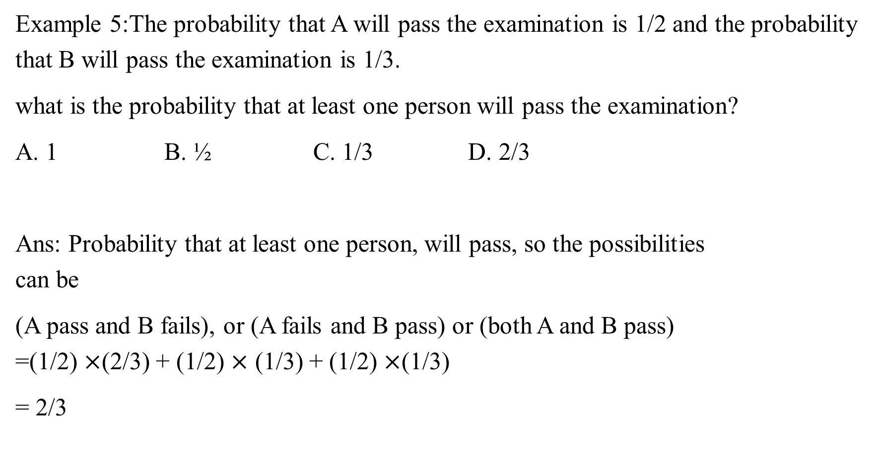
Example 5:The probability that A will pass the examination is 1/2 and the probability that B will pass the examination is 1/3.
what is the probability that at least one person will pass the examination?
A. 1 B. ½ C. 1/3 D. 2/3
Ans: Probability that at least one person, will pass, so the possibilities can be
(A pass and B fails), or (A fails and B pass) or (both A and B pass) =(1/2) $×$(2/3) + (1/2) $×$ (1/3) + (1/2) $×$(1/3)
= 2/3

Slide 15
Example 6: A bag contains 3 white balls and 2 black balls. another bag contains 2 white and 4 black balls. a bag and a ball are picked random. the probability that the ball will be white is:
A.7/11 B.7/30 C.5/11 D.7/15
Ans: The probability of selecting one bag =1/2
now, probability of getting a white ball from bag A:
=1/2×3/5=3/10
and probability of getting a white ball from bag B:
=1/2×2/6=1/6
hence, probability that white ball is drawn either first or second bag:
=3/10+1/6=7/15

Slide 16
Example 7:I forgot the last digit of a 7-digit telephone number. if I randomly dial the final 3 digits after correctly dialling the first four, then what is the chance of dialling the correct number?
A.1/1001 B.1/1000 C.1/999 D.1/990
Ans: It is given that last three digits are randomly dialled, then each of the digit can be selected out of 10 digits in 10 ways.
hence required probability
=(1/10)3
=1/1000

Slide 17
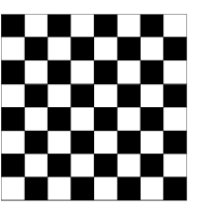
Example 8:Two squares are chosen at random on a chessboard. what is the probability that they have a side in common?
A.1/18 B.64/4032 C.63/64 D.1/9
Ans: Sample space will be total ways of selecting 2 squares (order doesn't matter) out of available 64 squares.
so sample space=64C2
now there are 7 unique adjacent square sets in each row and each column.
i.e. favourable cases will be 7×(8 rows + 8 columns) = 112.
hence required probability
=(favourable cases/sample space)
=112/64C2
=1/18

Slide 18
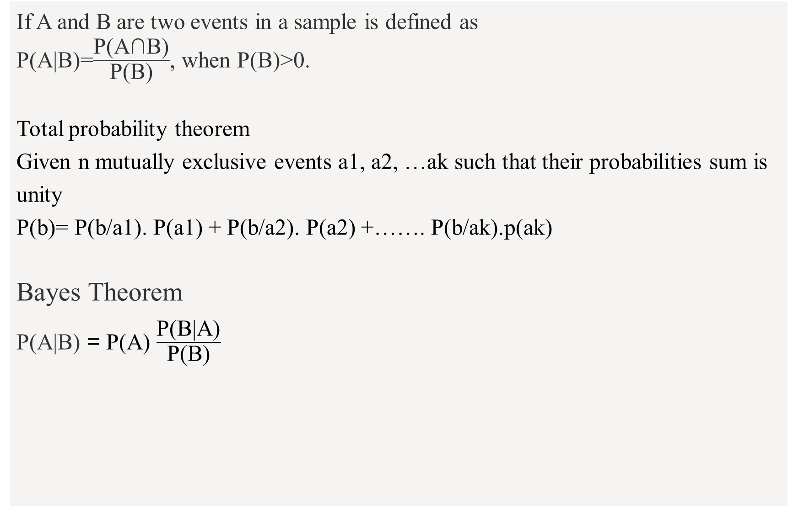
Conditional Probability
If A and B are two events in a sample is defined as
P(A|B)=$\frac{\text{P}\text{(}\text{A}\text{∩}\text{B}\text{)}}{\text{P}\text{(}\text{B}\text{)}}$, when P(B)>0.
Total probability theorem
Given n mutually exclusive events a1, a2, …ak such that their probabilities sum is unity
P(b)= P(b/a1). P(a1) + P(b/a2). P(a2) +……. P(b/ak).p(ak)
Bayes Theorem
P(A|B) = P(A) $\frac{\text{P}\text{(}\text{B}\text{|}\text{A}\text{)}}{\text{P}\text{(}\text{B}\text{)}}$

Slide 19
Example 9:Two urns contain 5 white and 7 black balls and 3 white and 9 black balls respectively. One ball is transferred to the second urn and then one ball is drawn from the second urn. Find the probability that the first ball transferred is black, given that the ball drawn is black?
A.13/23 B.11/23 C.14/23 D.7/23
Ans: P(A)= probability that the ball transferred from urn first to second is black:
=7/12
p(B)= probability that the ball drawn from second urn is black

Slide 20
Case I: If white ball goes to urn II
P(C)=5/12×9/13
Case II: If black ball goes to urn II
P(D)=7/12×10/13
Thus,
P(B)=P(C)+P(D)

Slide 21

=(45/156)+(70/156)
=115/156
P(A/B)= Probability of event a when b has occurred
⇒A $∩$ B/B
=$\frac{\text{P}\text{(}\text{the} \text{ball} \text{transferred} \text{from} \text{urn} \text{first} \text{to} \text{second} \text{is} \text{black}\text{ \& }\text{ball} \text{drawn} \text{from} \text{second} \text{urn} \text{is} \text{black}\text{)}}{\text{P}\text{(}\text{Probability} \text{that} \text{ball} \text{drawn} \text{from} \text{II} \text{urn} \text{is} black)}$
=(7/12×10/13)/(115/156)
=14/23

Slide 22

Example 10:Sita is getting married tomorrow, at an outdoor ceremony in the desert. In recent years, it has rained only 5 days each year. Unfortunately, the weatherman has predicted rain for tomorrow. When it actually rains, the weatherman correctly forecasts rain 90 of the time. When it doesn't rain, he incorrectly forecasts rain 10 of the time.What is the probability that it will rain on the day of sita's wedding?
A.0.567 B.0.111 C.0.332 D.0.732
Ans:
Event A1. It rains on Sita's wedding.
Event A2. It does not rain on Sita's wedding.
Event B. The weatherman predicts rain.

Slide 23
P(A1)=5/365=0.0136985 [it rains 5 days out of the year.]
P(A2)=360365=0.9863013 [it does not rain 360 days out of the year.]
P(B|A1)=0.9 [when it rains, the weatherman predicts rain 90% of the time.]
P(B|A2)=0.1 [when it does not rain, the weatherman predicts rain 10% of the time.]

Slide 24

P(A1|B)=$\frac{\text{P}\text{(}\text{A}\text{1)}\text{P}\text{(}\text{B}\text{|}\text{A}\text{1)}}{P(B)}$= $\frac{\text{P}\text{(}\text{A}\text{1)}\text{P}\text{(}\text{B}\text{|}\text{A}\text{1)}}{P(A1)P(B|A1)+P(A2)P(B|A2)}$
P(A1|B)=0.014×0.90.014×0.9+0.986×0.1
P(A1|B)=0.111

